Slide 3
What is data?
teminology

Slide 4
Visualize
Regression, clustering, Qlearning

Slide 5
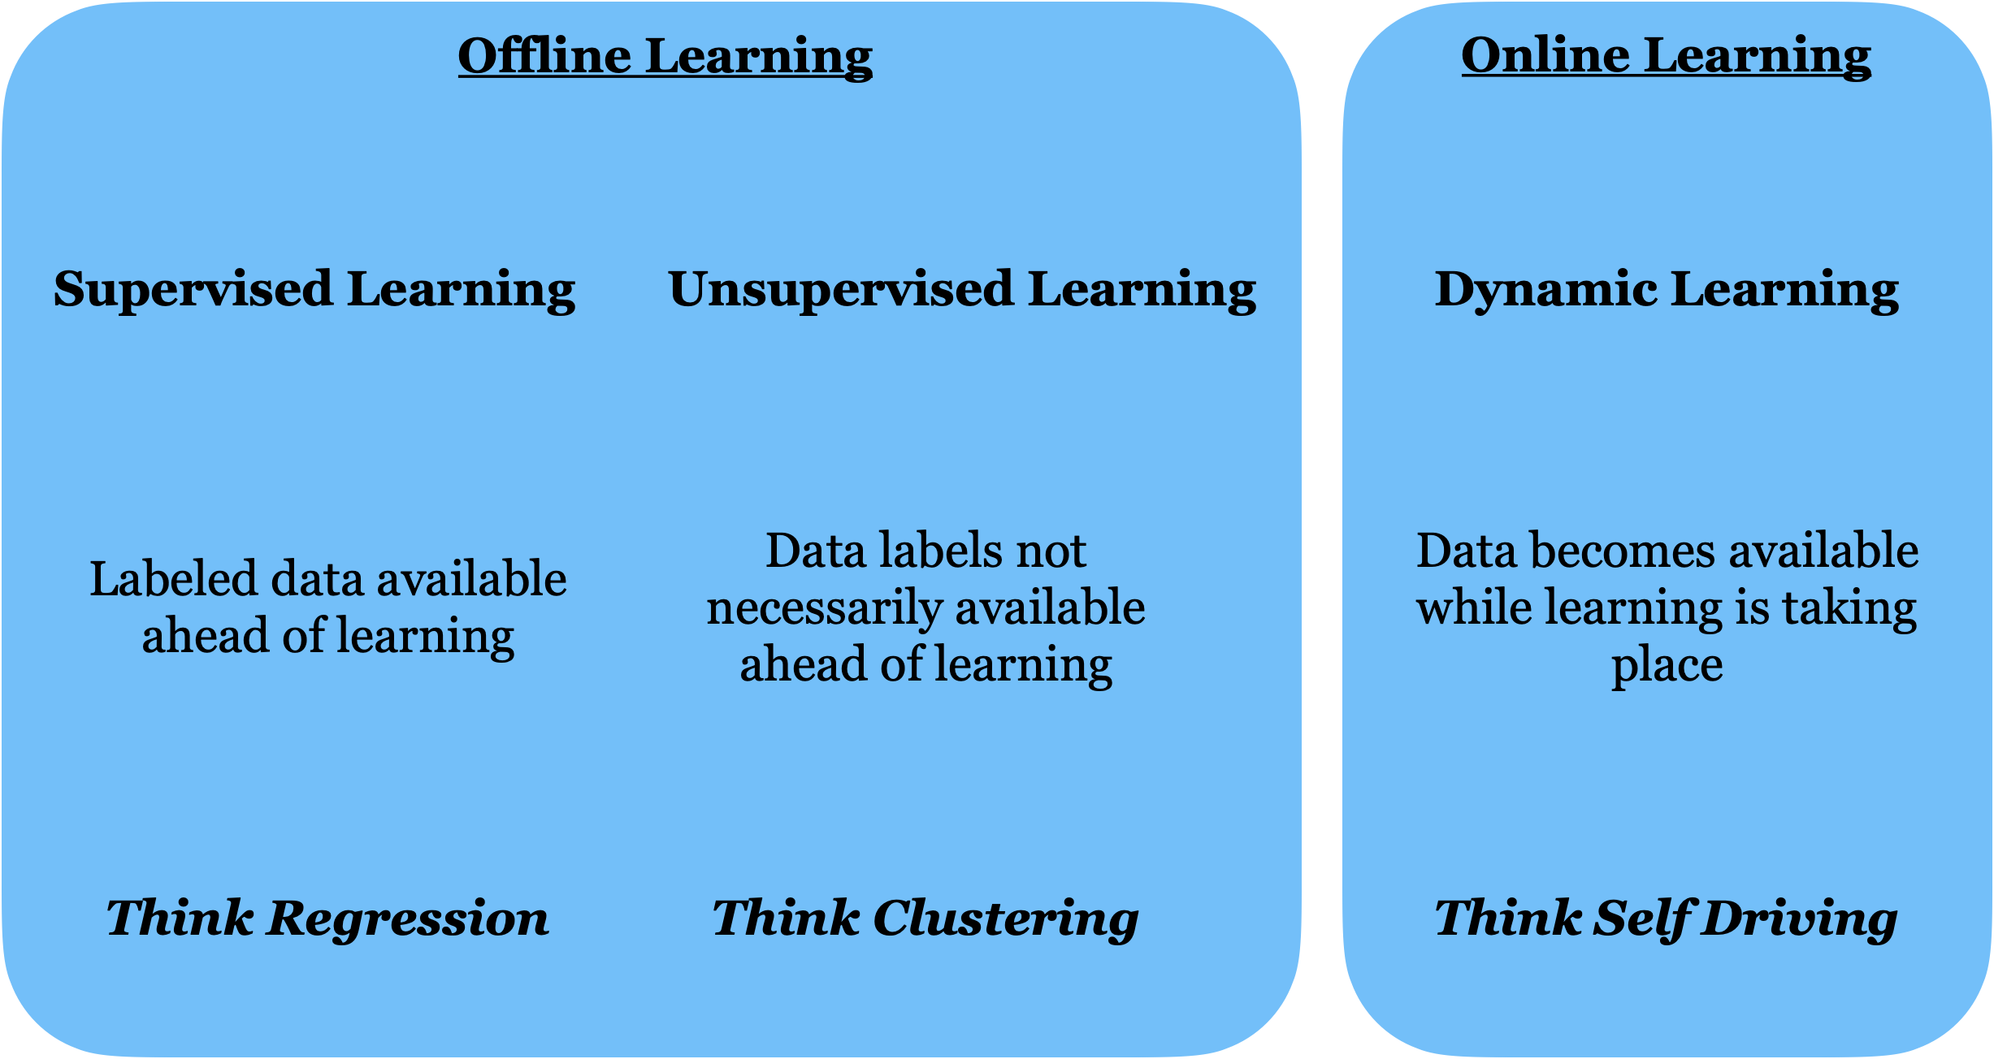

Slide 6
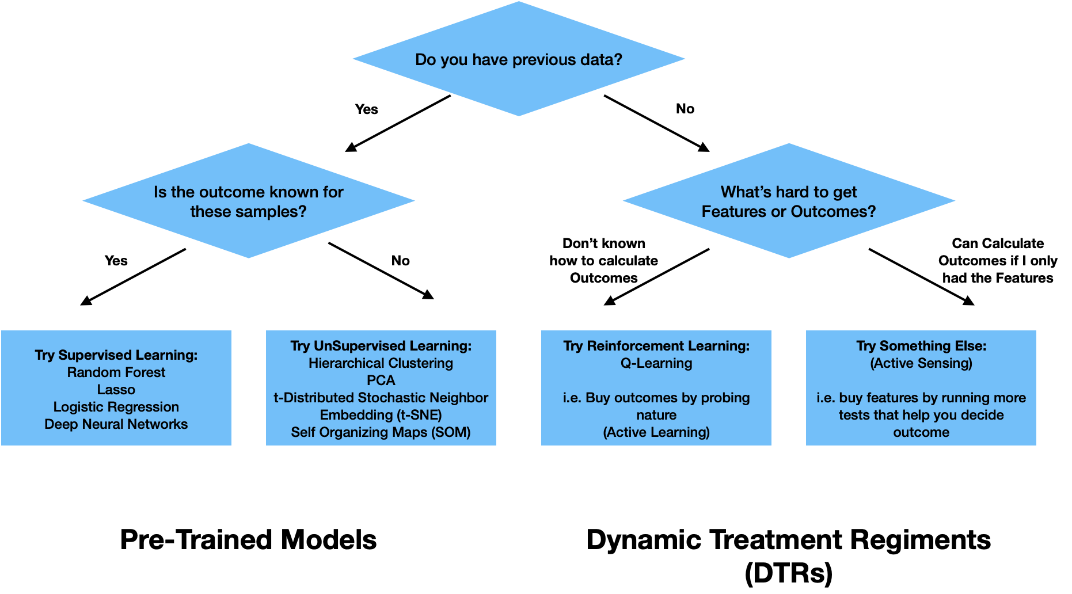

Slide 7


Slide 8
One layer deep = linear regression
Visualize one layer deep model (use this fig when teaching regression)

Slide 9
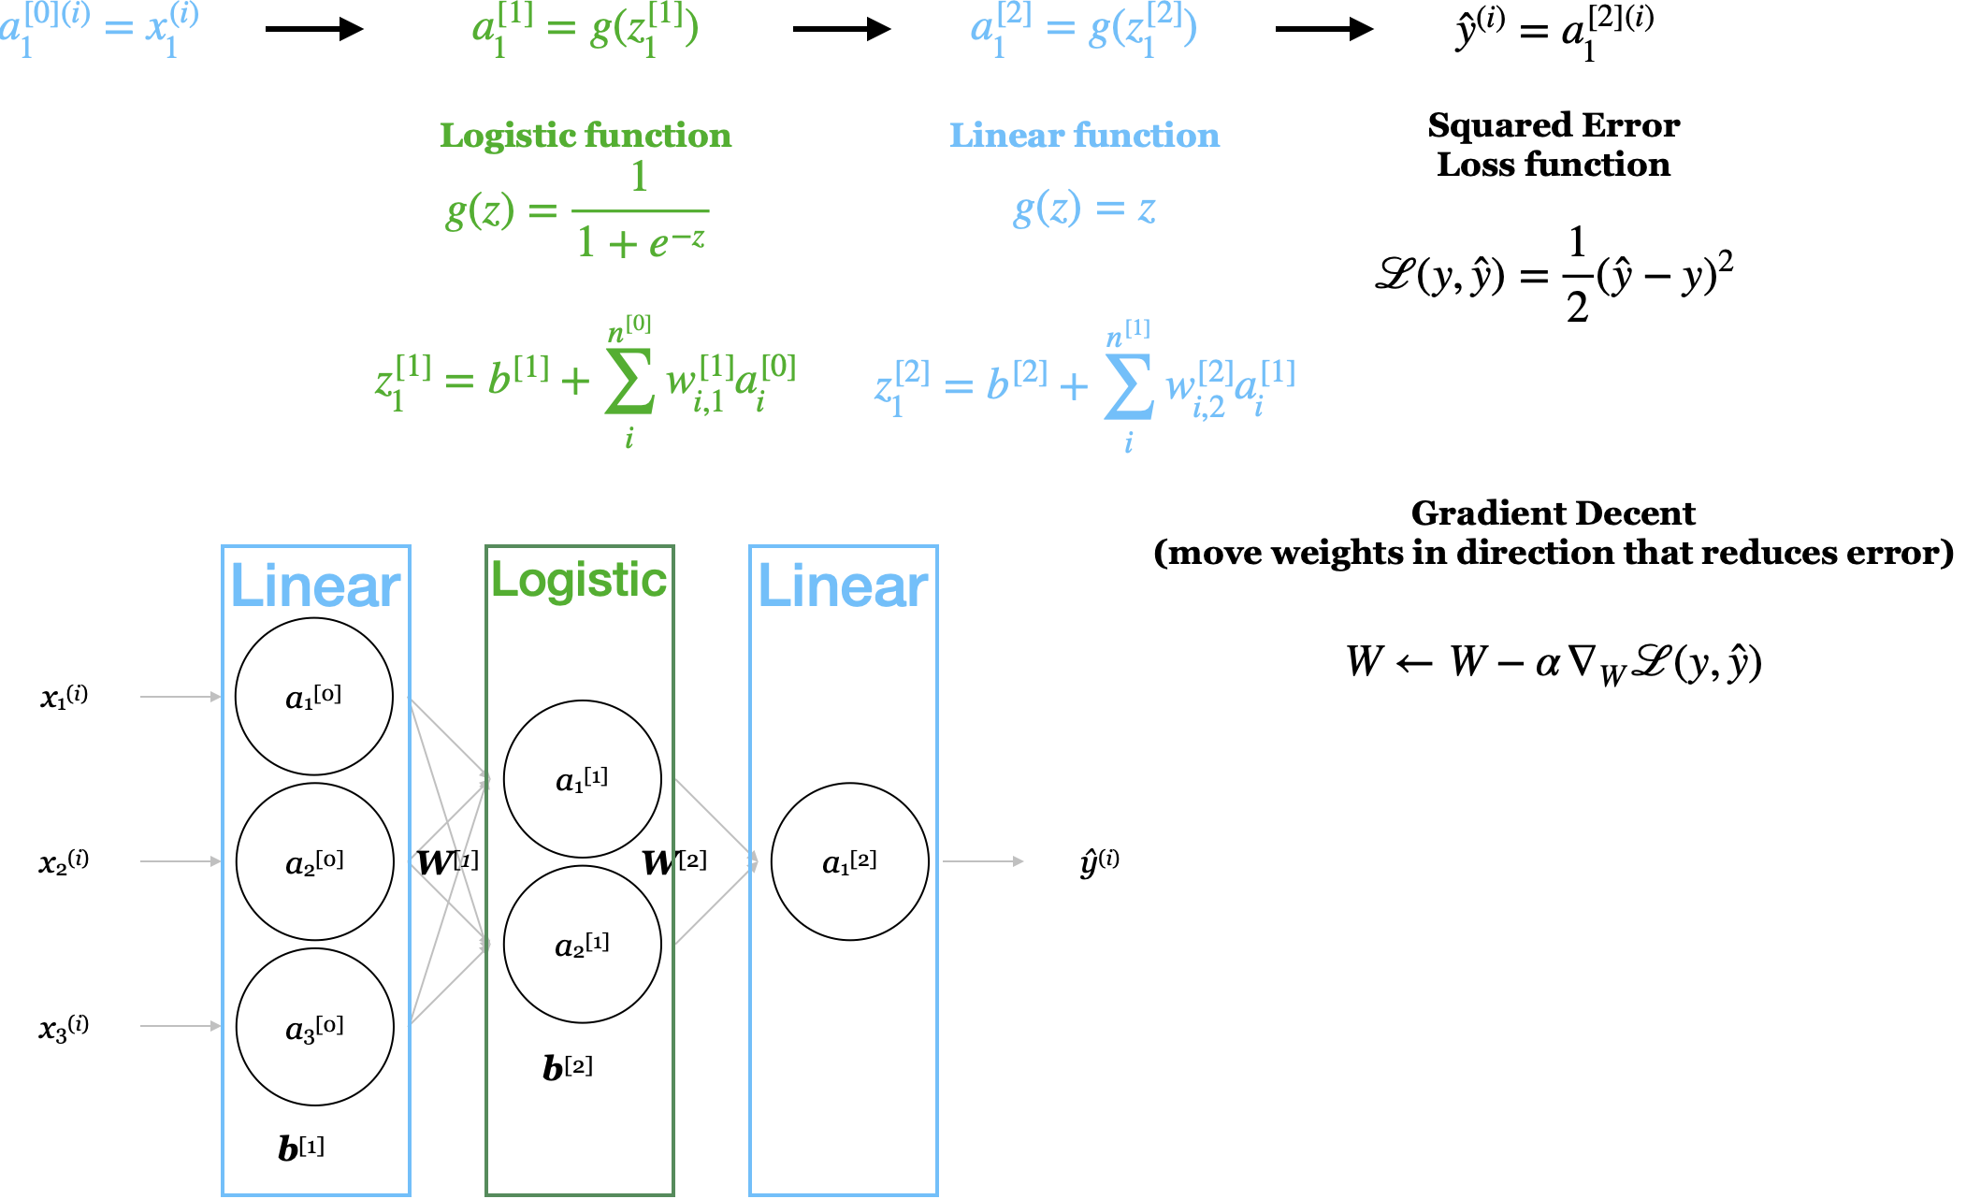
Notes:
Big sigma scary –figure for gratident decent

Slide 10
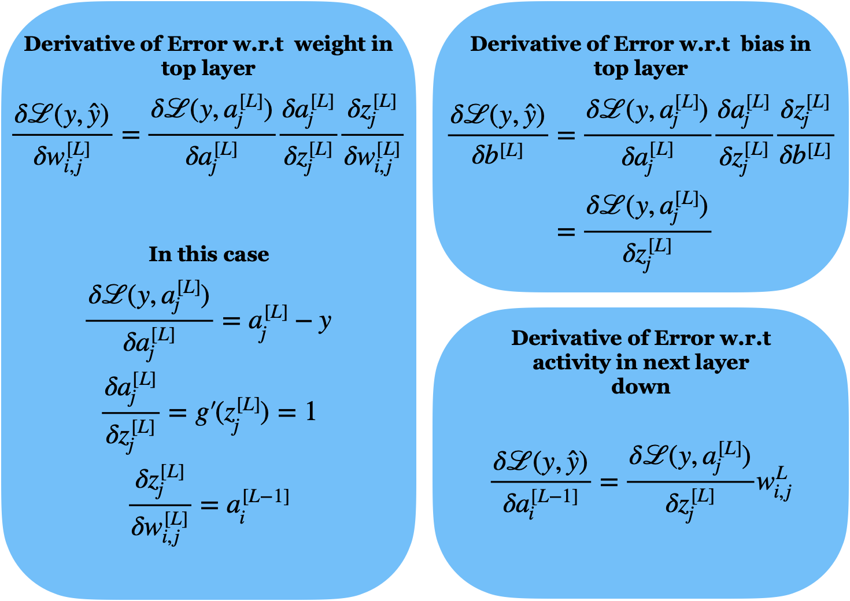

Slide 11
Cool examples

Slide 12
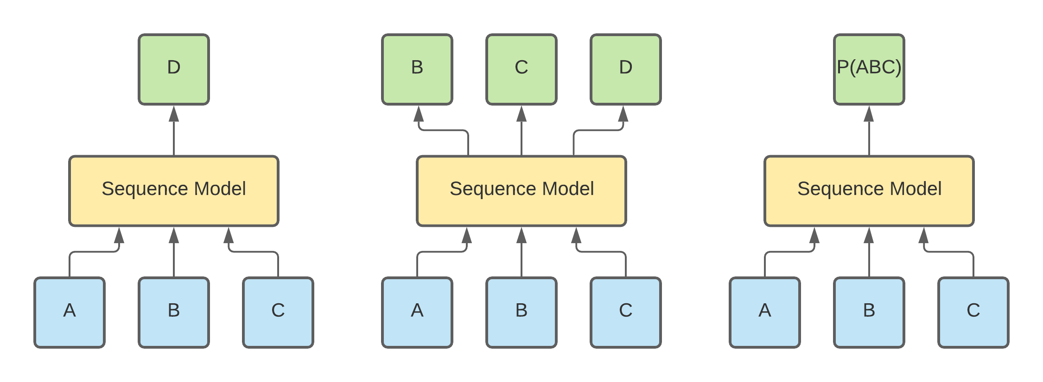
Notes:
GP3 – NPL examples

Slide 13
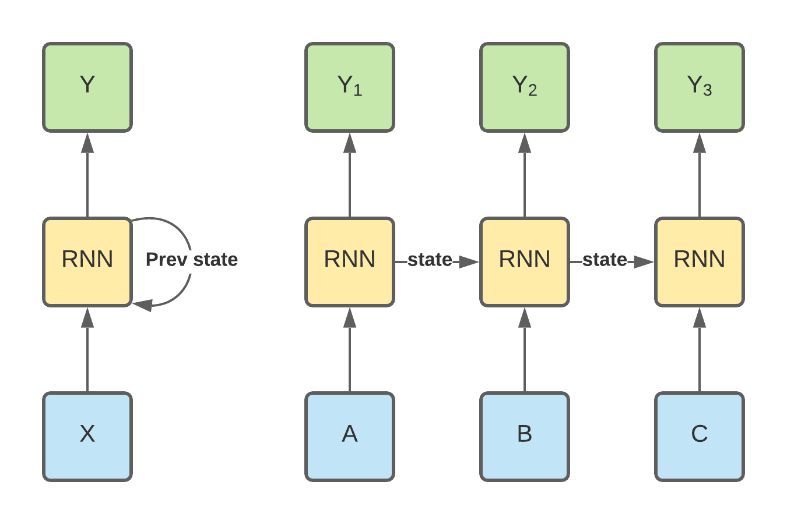

Slide 14
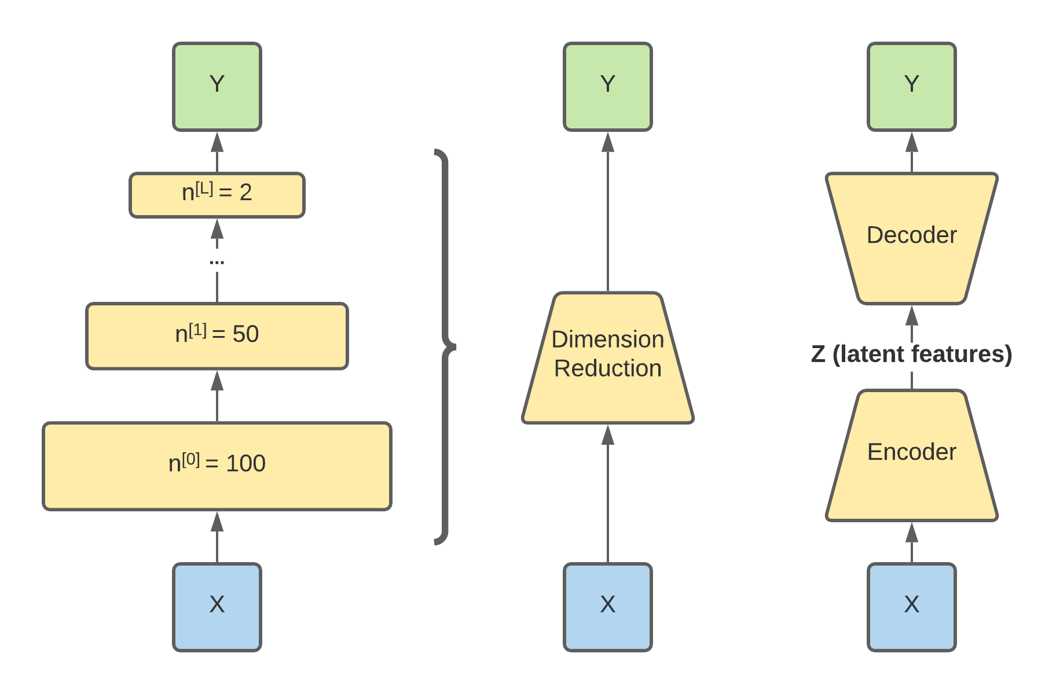

Slide 15
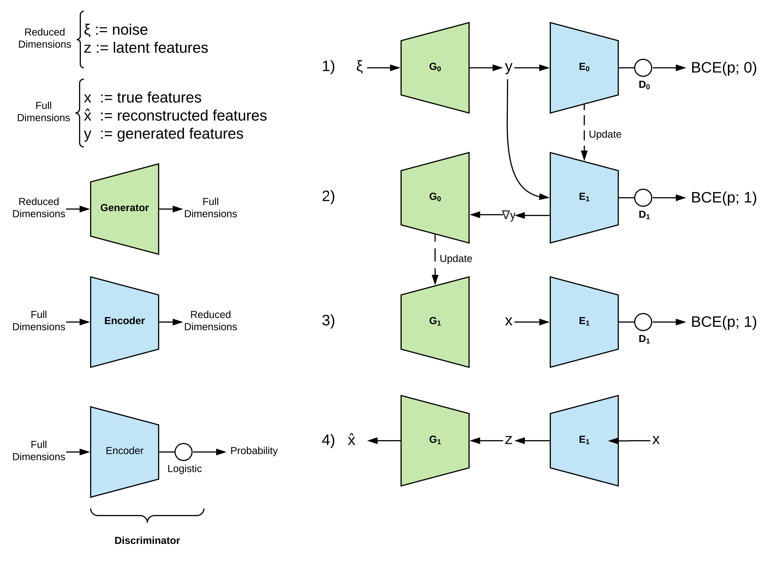
Generative
Adversarial
Networks
Notes:
Deep fakes and spoofing

Slide 16

Notes:
Bite sized

Slide 17
Why was the data collected? Think bout how the data was intended to be used.
Who was the author? Can inform your understanding of the data’s purpose.
What does the literature say? Cohorts and datasets are often well studied. (important features, clinical need)
What do the values represent vs what are they trying to represent.
Rectangular data : observational unit (samples), features (variables), classes (outcomes)
Categorical VS continuous features – (African American, Caucasian, Hispanic ) vs (height, weight, age)
Distribution/frequency/density –
Boundaries
Are there any holes
What is distance between values/categories
Infs and missing values
Normally distributed
Prevelance
Ordered:
Categorical on a scale of 1 to 5
Words in a sentence like the pangram “The quick brown fox jumps over the lazy dog.”
Amino acids in a protein sequence
Time-ordered like the in the molecular dynamics at the Newtonian level or the exciton transport at the quantum level
Fluctuating stock prices

Slide 18
QA/QC issues:
Was the data manually entered? – do features have values like “day1”, ”Day2”, day 3”
What are limits of detection for measurements? 1 millimole , 1 centimeter, 1 K, 1 second
Do measurements between days or sessions drift? Batch effects
Where are the feature outliers?
Do outliers in one feature tend to also be outliers in another?
Are the mean, median, and mode similar?
Are there any features with near zero variance?
Are there any overwhelming categories?
Correlations
How are features associated with the classes? Rsquared, t-tests
Do categories have similar class distributions?
Are features correlated? Redundant data, Heatmaps, dimension reduction
Formatting, treat missing, transformations, feature selection -> Tidy data

Slide 19
Hypothesis Generation vs Hypothesis Testing
Exploratory Data Analysis
Statistical analyses aimed to discover important relationships in order to suggest hypotheses to test.
[ Histograms | Box Plots | Correlation Matrices | Principal Components ]
Statistical Hypothesis Testing
Statistical inference based on the predicted outcomes resulting from hypothesis relative to some alternative hypotheses. (How confident are we the observed outcomes result from an actual relationship rather than just by coincidence?)
[ Sensitivity | Specificity | P-values ]
Notes:
Confirmation bias -

Slide 20
EDA slide
PCA interactive tool how it works

Slide 21
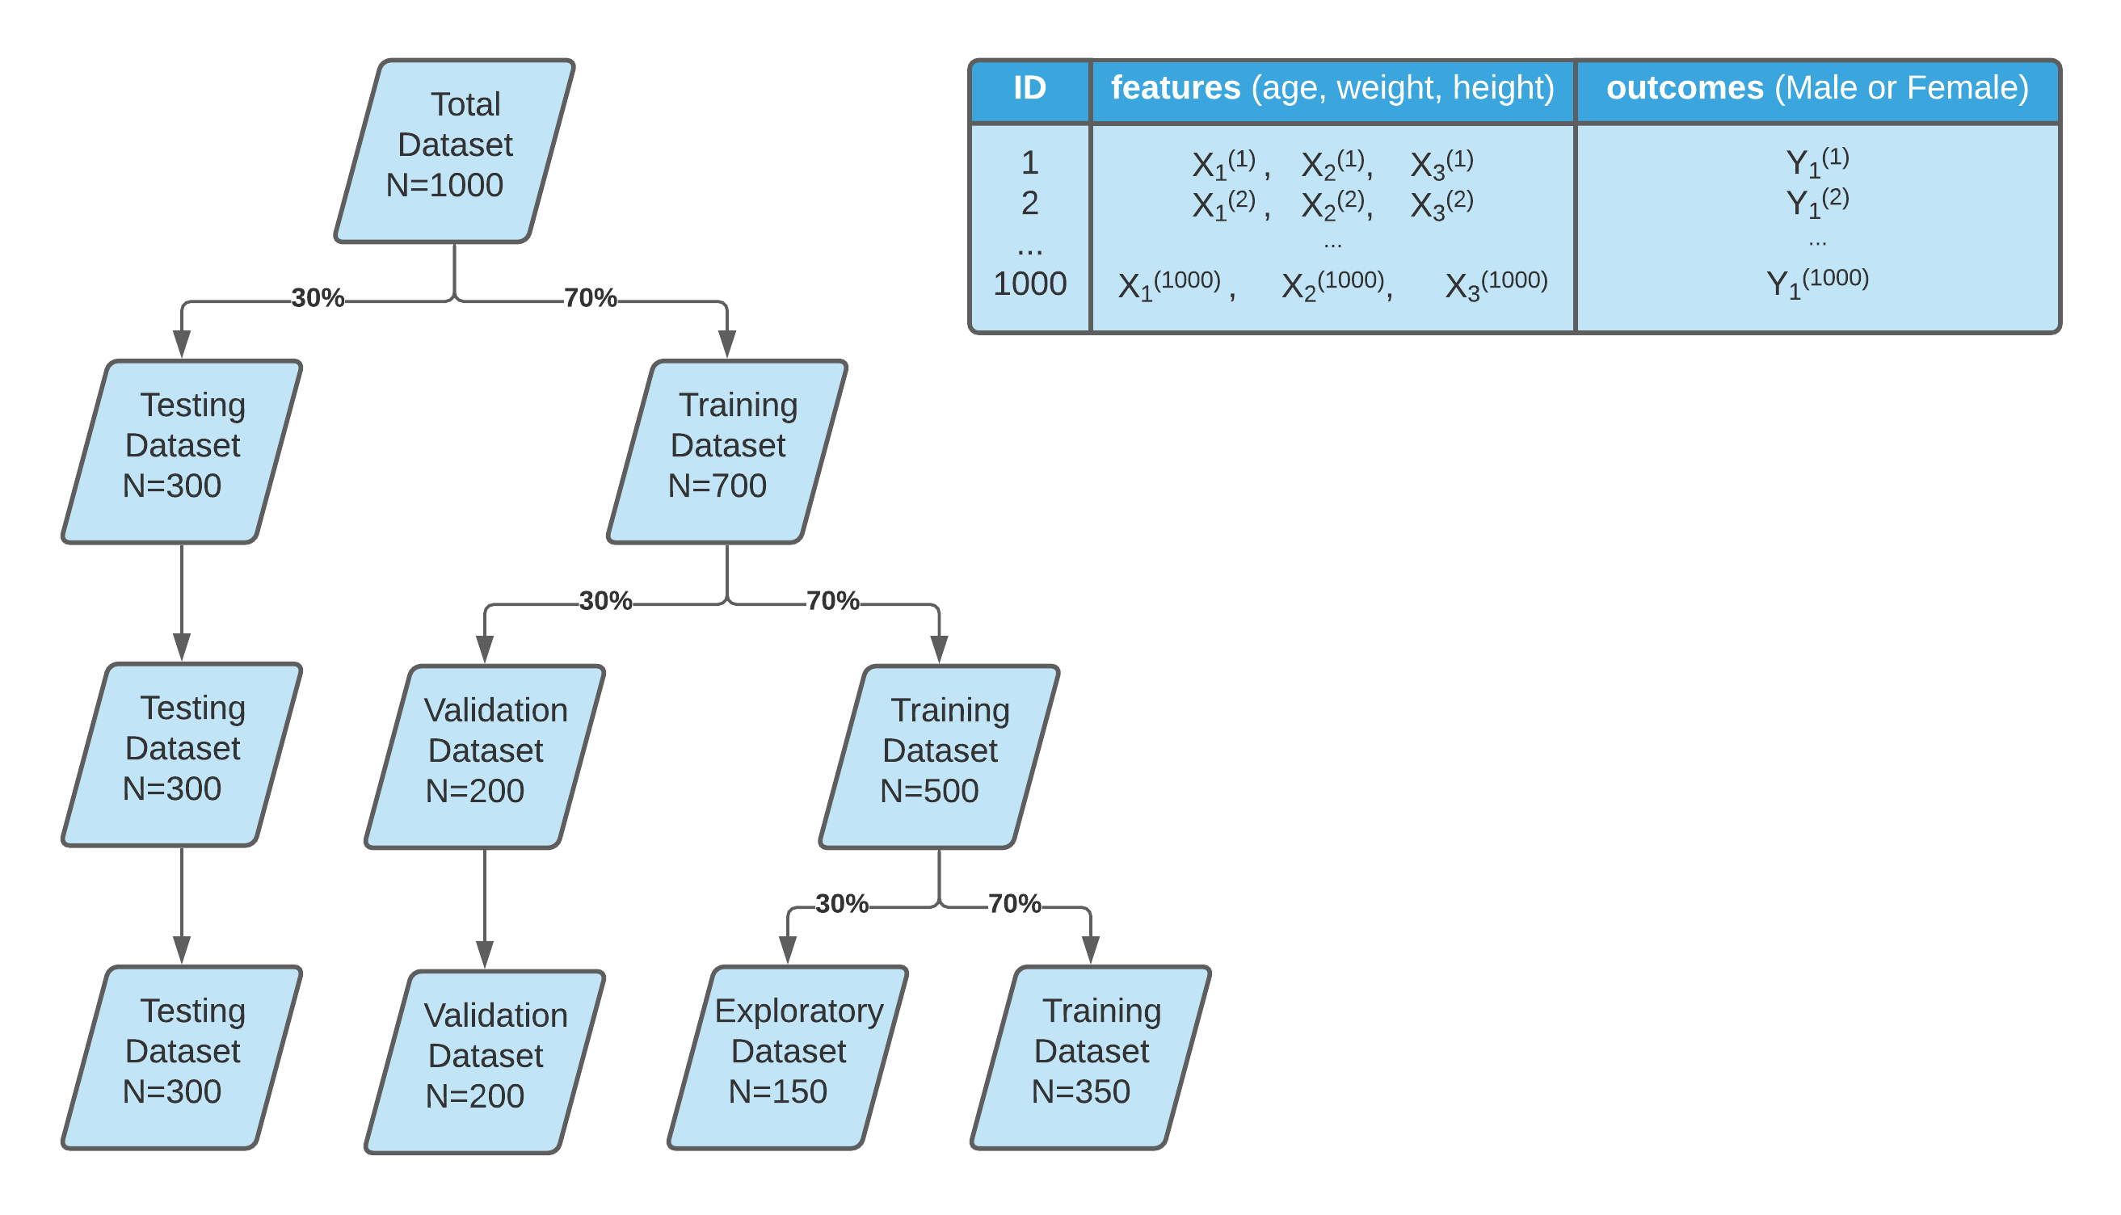

Slide 22
Getting to know your data
Lew M.J. (2019) A Reckless Guide to P-values. In: Bespalov A., Michel M., Steckler T. (eds) Good Research Practice in Non-Clinical Pharmacology and Biomedicine. Handbook of Experimental Pharmacology, vol 257. Springer, Cham. https://doi.org/10.1007/164_2019_286

Slide 23
On P-values
Culprits
Misunderstood
Misapplied
Answer questions no on asks
Unintentional p-hacking

Slide 24
Hypothesis test and Significance test
P < 0.05 is arbitray (but not unreasonable)
Neyman 1933: Type 1 erros (FP) and errors type 2 errors (FN) to formalize the concept of power.
More N = better Stats, More N = More $$$
Long deep history has crystalized p>0.05 dogma.
Frequentist approach can only reject the Null hypothesis.

Slide 25
Contradictory Instructions
Sometimes details of experiments cannot be reproduced 100%.
Judgments and debates on what is appropriate often driven by conviction rather than data.
P-value dogma -> conviction

Slide 26
P-values are not linear

Slide 27
Story telling and P-hacking

